Slide 1
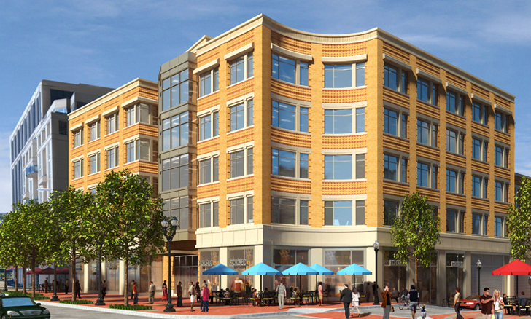
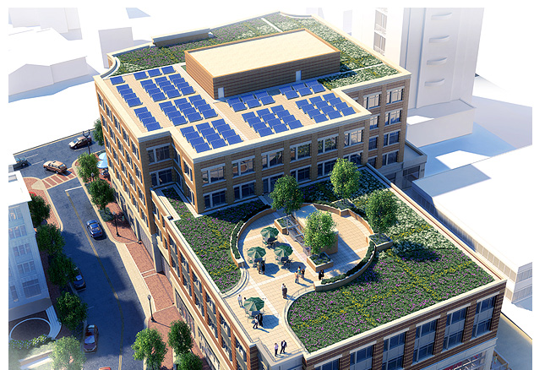
1776 WILSON BOULEVARD
ARLINGTON VIRGINIA
Penn State University
Senior Thesis 2012
Faculty Advisor: Thomas Boothby
Joshua Urban
Structural Option

Slide 2
PRESENTATION OVERVIEW
BUILDING INTRODUCTION AND EXISTING INFORMATION
PROPOSAL OVERVIEW
STRUCTURAL DEPTH
CONSTRUCTION MANAGEMENT BREADTH SUMMARY
SUSTAINABILITY BREADTH
Penn State University
Senior Thesis 2012
Faculty Advisor: Thomas Boothby
Joshua Urban
Structural Option

Slide 3
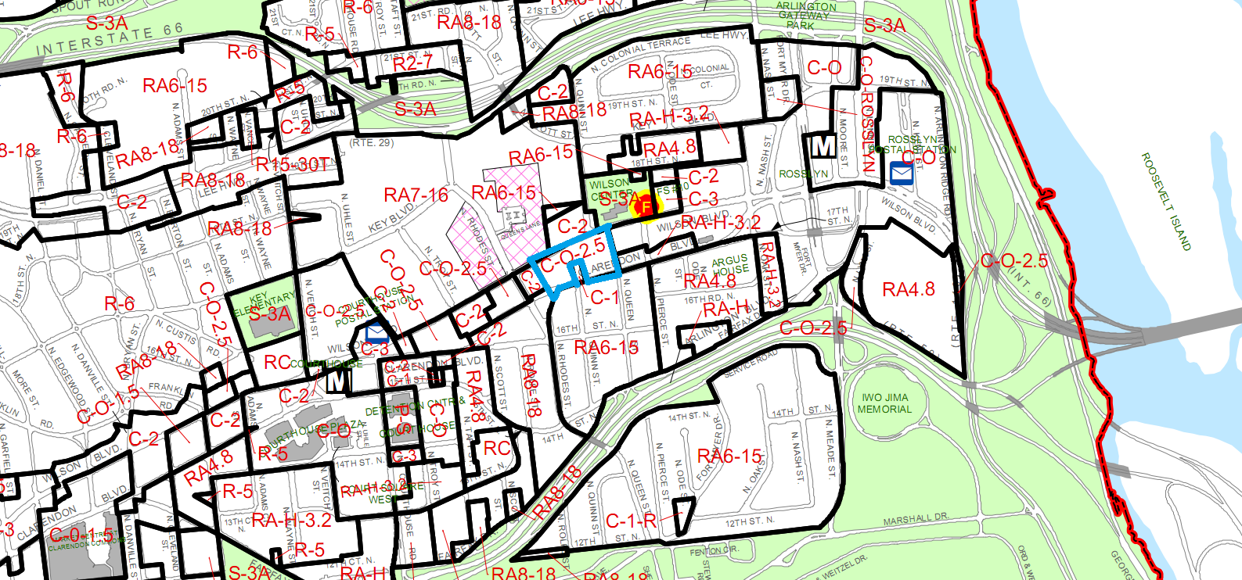
I
N
T
R
O
D
U
C
T
I
O
N
I
N
T
R
O
BUILDING STATISTICS
LOCATED IN ARLINGTON COUNTY, VIRGINIA
E
X
I
S
T
CLASS A OFFICE WITH RETAIL
249,000 SF
5 STORIES WITH 3 ½ BELOW GRADE PARKING
$63.5 MILLION CONTRACT VALUE
DESIGN-BID-BOND
D
E
P
T
H
C
M
C-O-2.5 ZONING DISTRICT
SEPARATE MIXED USE
S
U
S
T

Slide 4
I
N
T
R
O
D
U
C
T
I
O
N
I
N
T
R
O
ARCHITECTURE AND SUSTAINABILITY
RETAIL SPACE ON GROUND FLOOR WITH TENNANT MEZZANINES
4 FLOORS OF OPEN OFFICE SPACE
PRECAST CONCRETE PANELS
GENEROUS GLAZING AND CURTAIN WALLS
REDUCED TRAFFIC IMPACT
PUBLIC PARK AREA AND ROOF TERRACE
E
X
I
S
T
D
E
P
T
H
C
M
BROWNFIELD REDEVELOPMENT
GREEN ROOF AND SOLAR PV PANELS
S
U
S
T

Slide 5
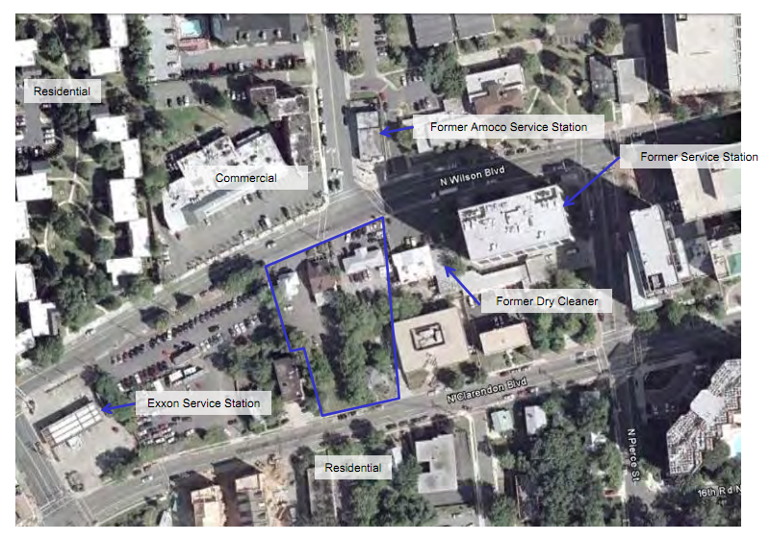
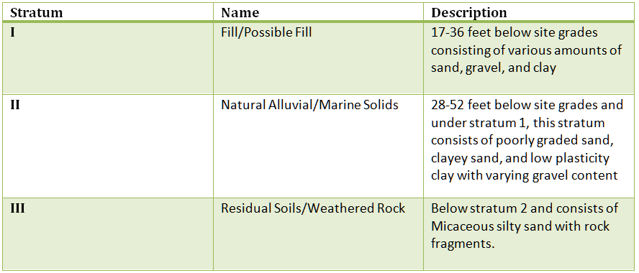
I
N
T
R
O
SITE CONDITIONS
S
T
R
U
C
T
U
R
E
E
X
I
S
T
I
N
G
E
X
I
S
T
ASPHALT, GRAVEL, AND TOPSOIL GROUND COVER
BELOW GROUND STRATA
HIGH GROUNDWATER FLOW
D
E
P
T
H
N
45,500 SF FOOTPRINT AREA
ONE AND TWO STORY BUILDINGS
C
M
S
U
S
T

Slide 6
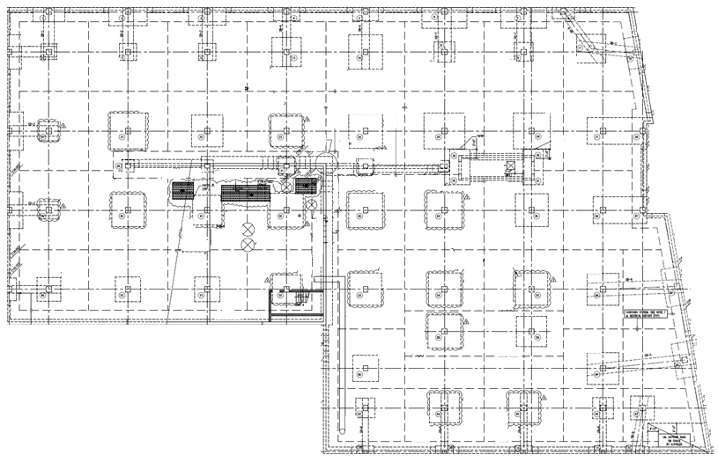
I
N
T
R
O
FOUNDATION
FLOOR SYSTEM
COLUMNS
S
T
R
U
C
T
U
R
E
ROOF
E
X
I
S
T
I
N
G
E
X
I
S
T
GROUND FLOOR 24” X 24” COLUMNS
22” X 22” TYPICAL COLUMNS ABOVE
5 TO 8 KSI CONCRETE STRENGTH
#9 TO # 11 REINFORCEMENT
SHALLOW FOUNDATION
BEARING CAPACITY OF 10,000 PSF
SLAB ON GRADE AND FOOTINGS
HIGH STRENGTH POST TENSIONED CONCRETE
FLAT SLAB WITH DROPS
30’ X 30’ AND 30’ X 45’ BAYS
LOWER ROOF TERRACE LIVE LOAD OF 100 PSF
25-26 PSF FOR GREEN ROOF
SOLAR PANELS ADD 6.6 – 8 PSF TO DEAD LOAD
ROOF COVERAGE IS VEGETATION, ROOF PAVERS, OR WEARING SLAB
8 TO 10 INCHES THICK
D
E
P
T
H
C
M
S
U
S
T

Slide 7
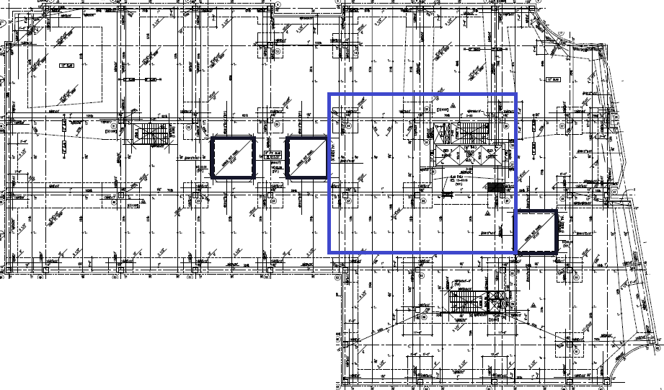
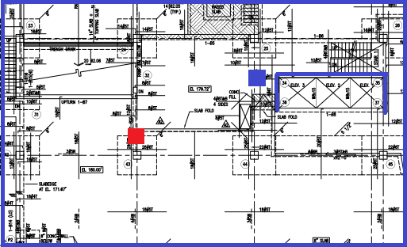
I
N
T
R
O
LATERAL SYSTEM
S
T
R
U
C
T
U
R
E
E
X
I
S
T
I
N
G
E
X
I
S
T
CONCRETE MOMENT FRAMES AND SHEAR WALLS
LOWEST R VALUE USED FOR DUAL SYSTEM
SLABS SERVE AS BEAMS
EACH COLUMN PARTICIPATES IN RESISTANCE
10” AND 12” SHEAR WALLS
TORSION AID
D
E
P
T
H
C
M
S
U
S
T

Slide 8
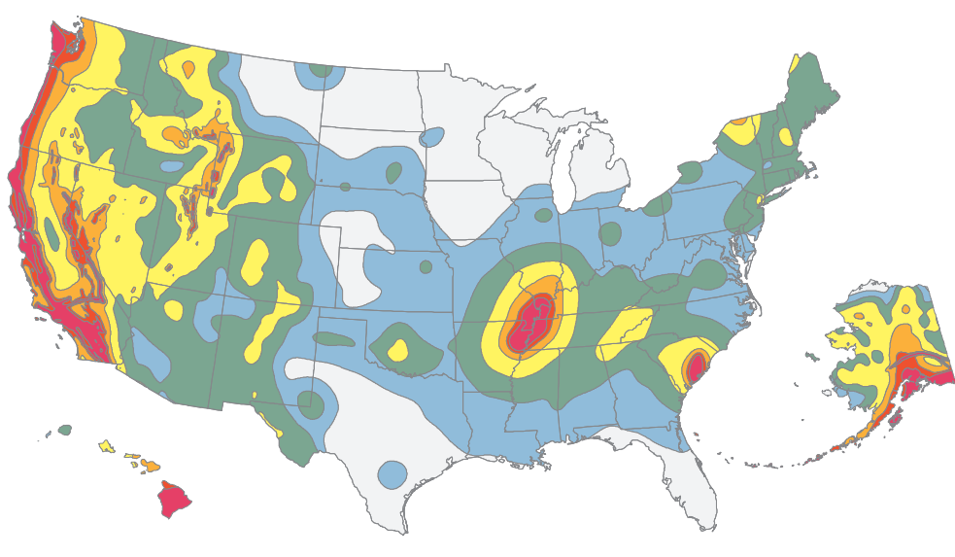
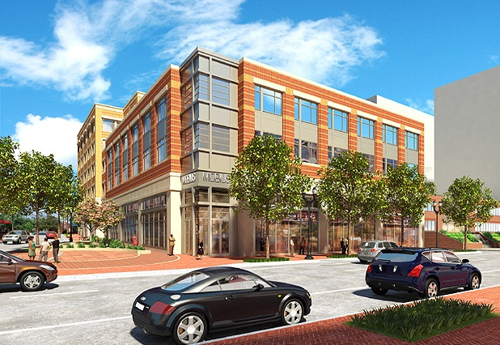
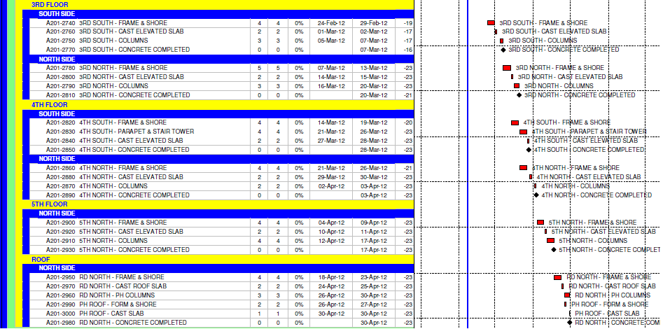
PROPOSAL
EFFICIENTLY DESIGNED
LOCATION CHANGE
REDESIGN FOR NEW SEISMIC LOADS
CONSTRUCTION MANAGEMENT
SUSTAINABILITY

Slide 9
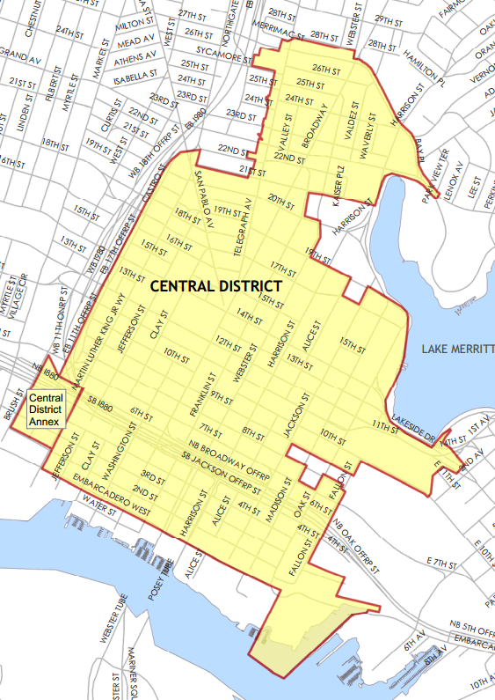
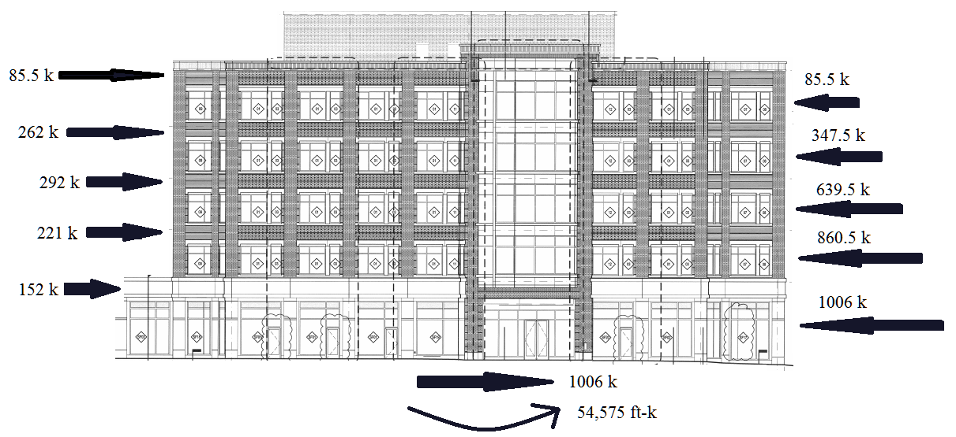
I
N
T
R
O
NEW SEISMIC LOADS
S
T
R
U
C
T
U
R
A
L
NEW LOCATION
E
X
I
S
T
CENTRAL DISTRICT OAKLAND
LEED RELATED SITE BENEFITS
REDEVELOPMENT
DEPTH
D
E
P
T
H
C
M
S
U
S
T

Slide 10
I
N
T
R
O
S
T
R
U
C
T
U
R
A
L
SEISMIC DESIGN CONSIDERATIONS
E
X
I
S
T
SPECIAL MOMENT FRAMES REQUIRED
REDUNCANCY FACTOR = 1.3
(1.2 + 0.2Sds)D + ρQe + L + 0.2S
(0.9 – 0.2Sds)D + ρQe + 1.6H
ALLOWABLE STORY DRIFT = 0.02hsx
EQUIVALENT LATERAL FORCE ANALYSIS PERMITTED
SEISMIC DESIGN CATEGORY D
DEPTH
D
E
P
T
H
SEISMIC PROVISIONS AISC 341-05
SLENDERNESS : Kl/r ≤ 4√E/Fy
WIDTH/THICKNESS RATIO: b/t ≤ 0.30√E/Fy
NO SHEAR STUDS IN PROTECTED ZONES
C
M
S
U
S
T

Slide 11
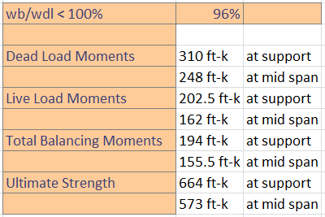
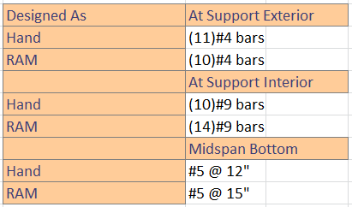
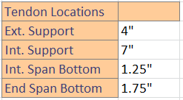
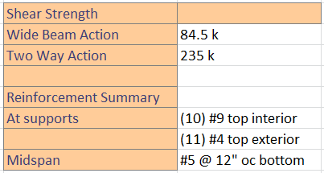
I
N
T
R
O
S
T
R
U
C
T
U
R
A
L
CONCRETE REDESIGN
E
X
I
S
T
F’c = 6000 PSI
Fy = 60 KSI
Fpu = 270,000 PSI
7 WIRE STRANDS ½” DIAMETER
60% LOAD BALANCE OF SELF WEIGHT
DEPTH
INCREASE IN MEMBER SIZES
INCREASE IN EDGE REINFORCEMENT
INCREASE IN COLUMN/SLAB CONNECTION REINFORCEMENT
COMPLEX DETAILING
D
E
P
T
H
C
M
S
U
S
T

Slide 12
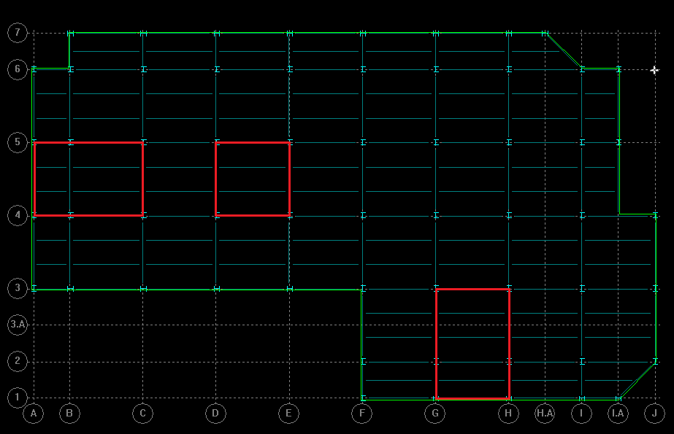
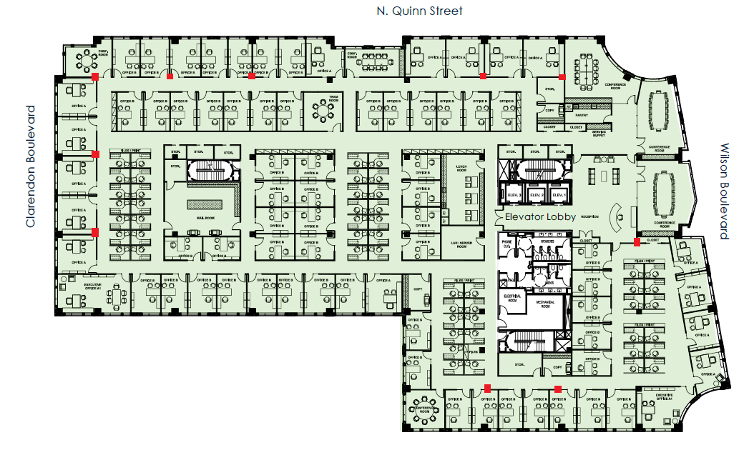
I
N
T
R
O
S
T
R
U
C
T
U
R
A
L
COMPOSITE STEEL PRO/CON
GRAVITY SYSTEM
E
X
I
S
T
LOWER WEIGHT
DECREASED CONSTRUCTION TIME
FRAMING PLANS
HAND CALCULATIONS
RAM STRUCTURAL SYSTEM MODEL
DEPTH
D
E
P
T
H
ADDITIONAL FIREPROOFING
VIBRATION ISSUES
BELOW GRADE PARKING
C
M
S
U
S
T

Slide 13
I
N
T
R
O
S
T
R
U
C
T
U
R
A
L
RAM STRUCTURAL SYSTEM
E
X
I
S
T
HAND CALCULATION RESULTS USED TO ASSIGN SIZES
CRITERIA SET FOR BEAM/ COLUMN CHECKS AND BEAM DEFLECTION
ECONOMIZE LAYOUTS
DEPTH
D
E
P
T
H
C
M
S
U
S
T

Slide 14
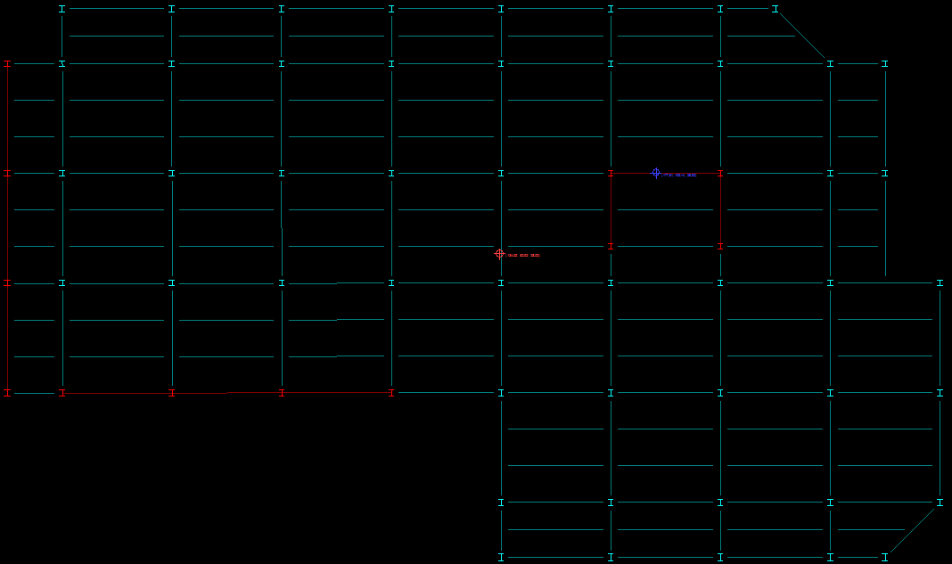
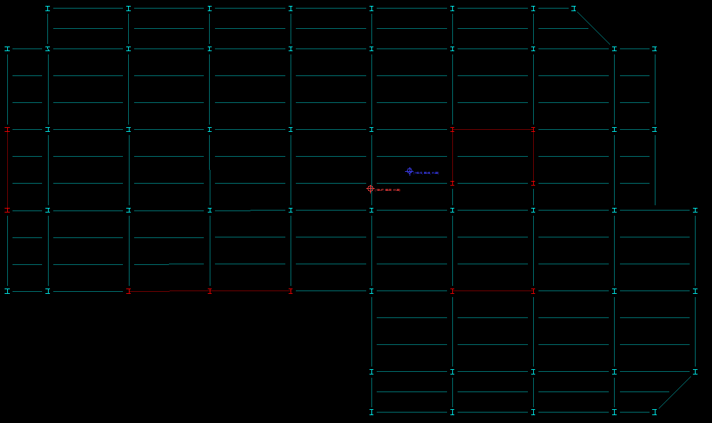
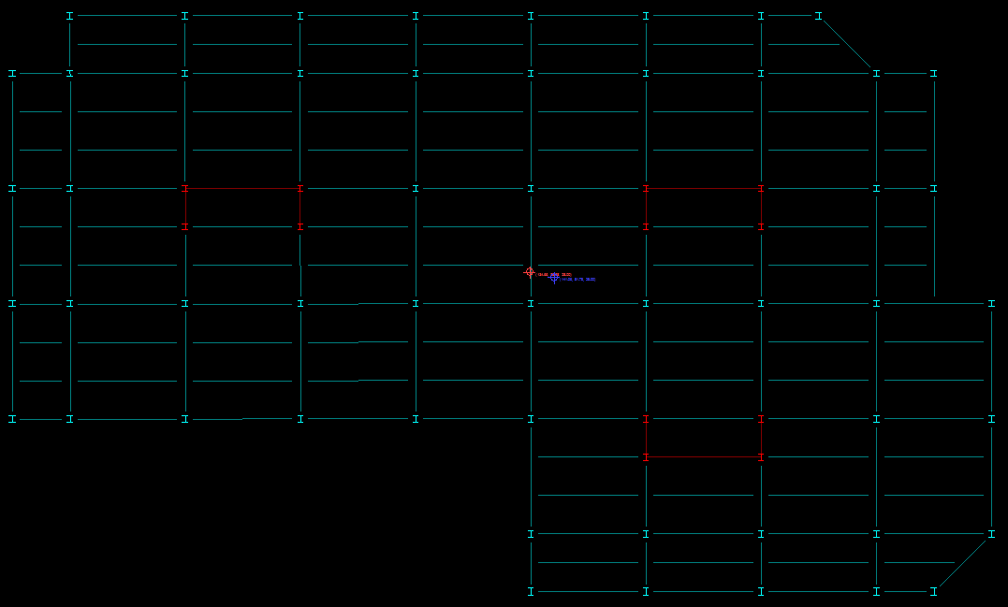
I
N
T
R
O
S
T
R
U
C
T
U
R
A
L
MOMENT FRAME LAYOUTS
E
X
I
S
T
1ST LAYOUT
DEPTH
2ND LAYOUT
CONSIDERATIONS
3rd LAYOUT
D
E
P
T
H
LIMIT DRIFT
AVOID P-DELTA INSTABILITIES
MINIMIZE EFFECTS DUE TO TORSION
MINIMIZE ARCHITECTURAL IMPACTS
BRACED FRAMES AROUND ELEVATOR CORE
PERIMETER MOMENT FRAMES
LARGE TORSION EFFECTS
BRACE PERIMETER FRAMES
UPLIFT ISSUES AT CORNERS
ARCHITECTURAL IMPACTS
THREE INTERIOR BRACED CORES
MINIMAL ARCHITECTURAL IMPACT
MINIMAL EFFECT DUE TO TORSION
C
M
S
U
S
T

Slide 15
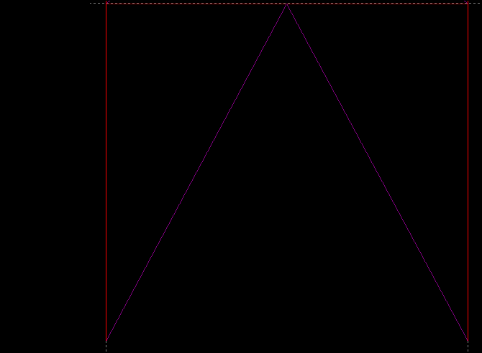
I
N
T
R
O
S
T
R
U
C
T
U
R
A
L
HAND CALCULATIONS
E
E
X
I
S
T
DEPTH
D
E
P
T
H
C
M
T
C
S
U
S
T

Slide 16
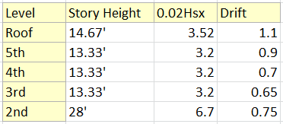
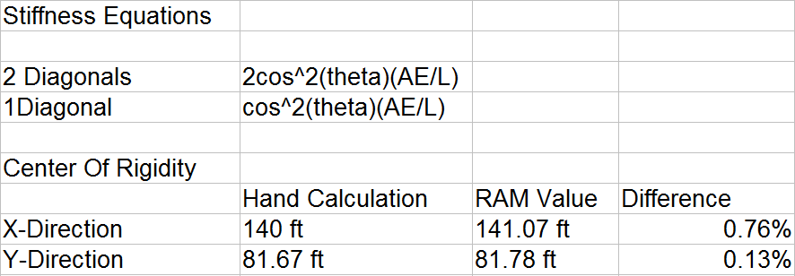
I
N
T
R
O
S
T
R
U
C
T
U
R
A
L
CONCLUSION
E
X
I
S
T
LIMIT DRIFT
AVOID P-DELTA INSTABILITIES
MINIMIZE EFFECTS DUE TO TORSION
MINIMIZE ARCHITECTURAL IMPACTS
DEPTH
D
E
P
T
H
C
M
S
U
S
T

Slide 17
I
N
T
R
O
C
M
B
R
E
A
D
T
H
OVERVIEW
CONCRETE SCHEDULE
STEEL SCHEDULE
E
X
I
S
T
TWO CRANES, KEEP NORTH AND SOUTH ZONES
TAKEOFFS PERFORMED BY HAND ON TYPICAL BAYS
SUPERSTRUCTURE SCHEDULE SHORTENED BY 10 DAYS
$625,000 INCREASE IN COST
FOLLOWS FORMAT OF ORIGINAL SCHEDULE
UPDATED DURATIONS BASED ON INCREASE IN MATERIALS
SUPERSTRUCTURE SCHEDULE EXTENDED 4 DAYS
$1.7 MILLION INCREASE IN COST
DON’T EXTEND SCHEDULE
COMPARE COSTS AND DURATIONS
DEVELOP CRITICAL PATHS
D
E
P
T
H
C
M
S
U
S
T

Slide 18
I
N
T
R
O
S
USTA
I
N
AB
L
E
OVERVIEW
E
X
I
S
T
BREADTH
MAINTAIN LEED PLATINUM RATING
PRIORITY LIST
NEW SITE
ENERGY PERFORMANCE
HVAC LOADS
D
E
P
T
H
C
M
S
U
S
T

Slide 19
I
N
T
R
O
S
USTA
I
N
AB
L
E
NEW SITE LOCATION
E
X
I
S
T
BREADTH
CENTRAL DISTRICT OAKLAND
BROWNFIELD OPPORTUNITIES
REDUCE TRAFFIC IMPACT
HEAT ISLAND
D
E
P
T
H
C
M
S
U
S
T

Slide 20
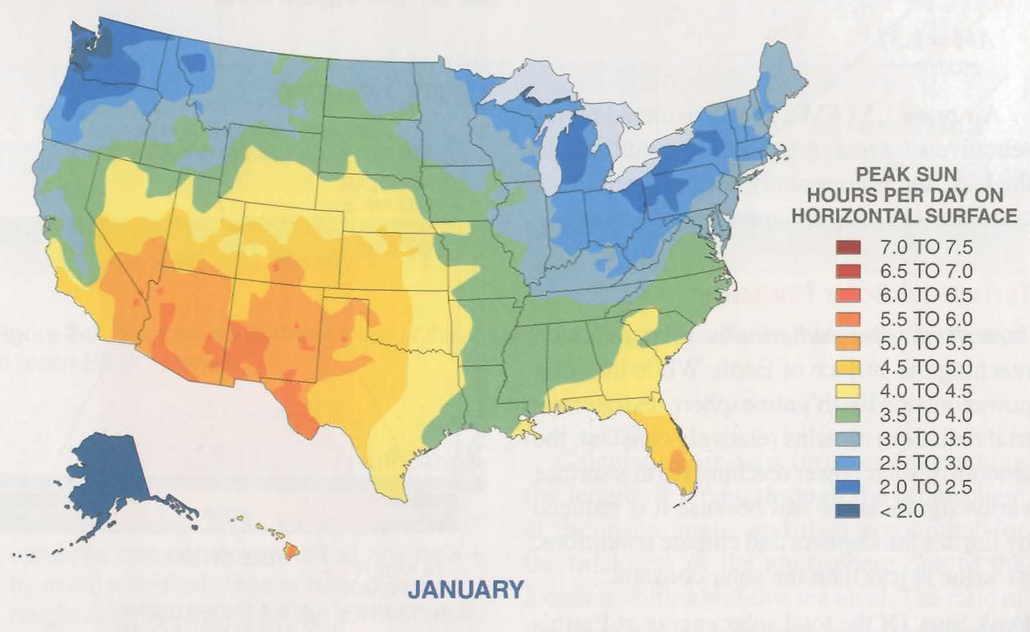
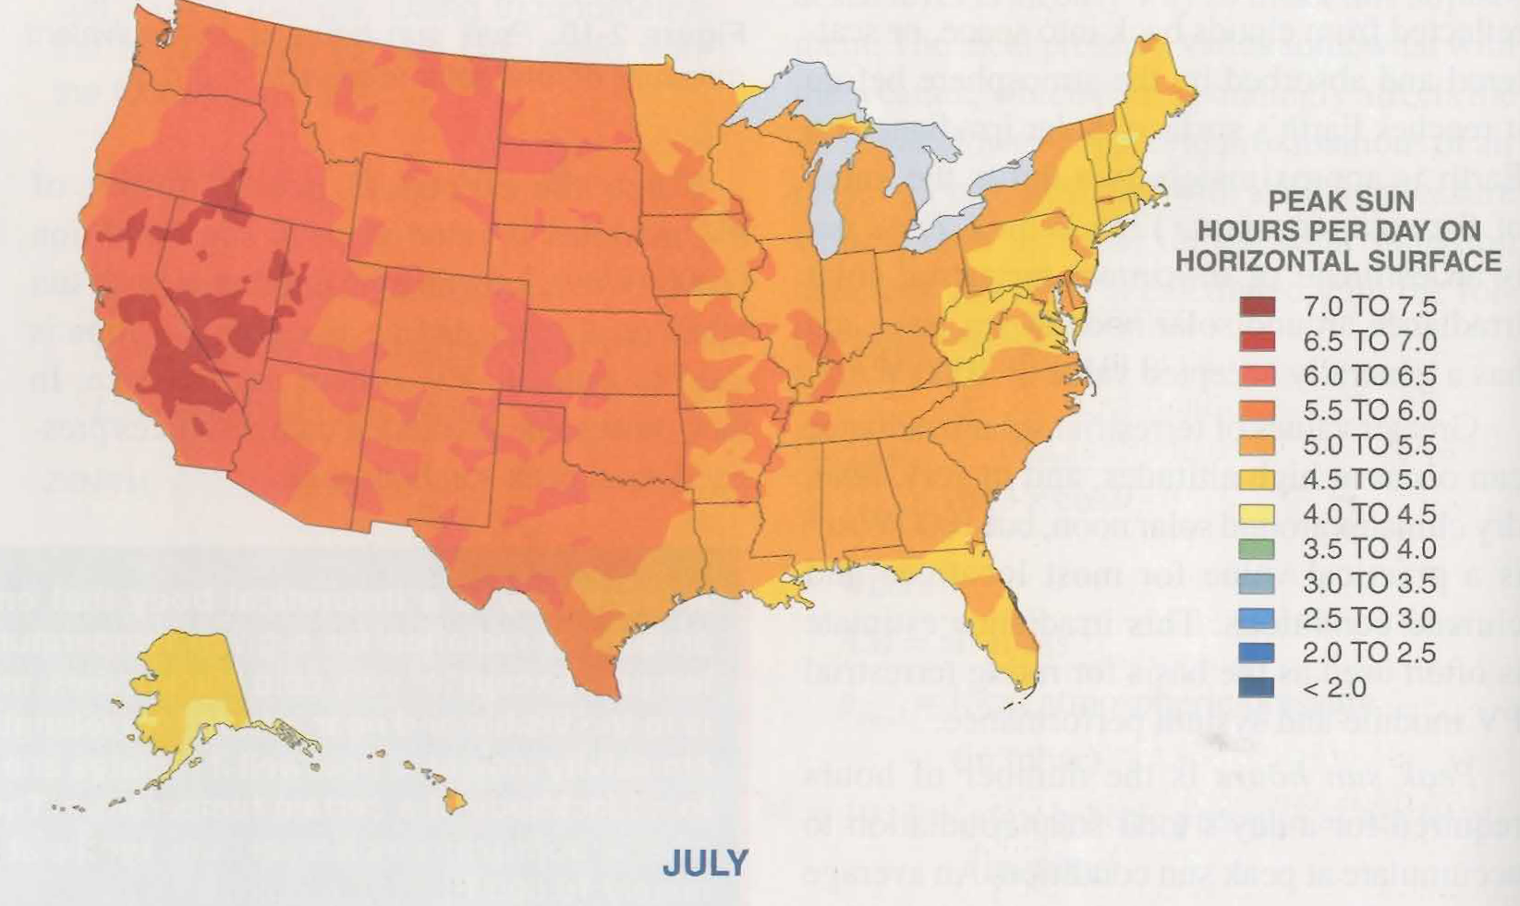
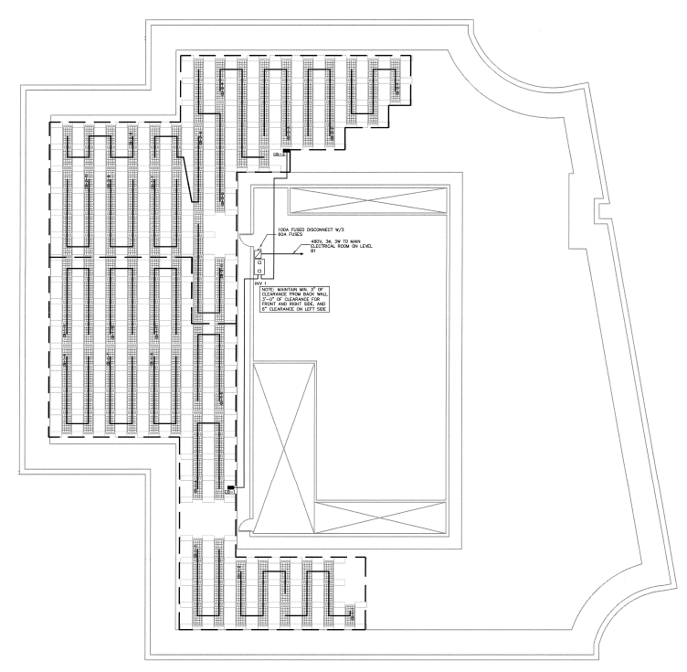
I
N
T
R
O
S
USTA
I
N
AB
L
E
SOLAR PANEL ANALYSIS
E
X
I
S
T
176 PANELS
2 COMBINER BOXES
8 PER STRING, 22 STRINGS
TOTAL SYSTEM SIZE OF 38.72KW
BREADTH
D
E
P
T
H
PEAK SUN HOURS DETERMINED
20% ASSUMED LOSSES TO AC
C
M
S
U
S
T
HAND CALCS VS PV WATTS

Slide 21
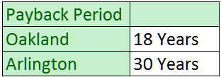
I
N
T
R
O
S
USTA
I
N
AB
L
E
SOLAR PANEL ANALYSIS
E
X
I
S
T
BREADTH
CONSIDERATIONS
D
E
P
T
H
ITC GRANT
ANNUAL UTILITY RATE INCREASES
OPERATION AND MAINTENANCE
METER AND INVERTER REPLACEMENTS
PRODUCTION DECREASES
C
M
S
U
S
T

Slide 22
I
N
T
R
O
S
USTA
I
N
AB
L
E
SOLAR PANEL ANALYSIS
CHECK EXISTING EFFICIENCY
USE 3% EFFICIENCY INCREASE
CALCULATE NEW SYSTEM SIZE
INCLUDE GREEN ROOF ADDITION IN COST
E
X
I
S
T
BREADTH
GREEN ROOF INTEGRATION
D
E
P
T
H
SOLAR PANELS INSTALLED OVER EXTENSIVE GREEN ROOF
PANELS SHADE VEGETATION
GREEN ROOF COOLS SOLAR PANELS
UP TO 6% MORE EFFICIENT
PAYBACK PERIOD : 23 YEARS
31 YEARS TO PROVIDE COST SAVINGS
OVER NON INTEGRATED SYSTEM
C
M
S
U
S
T

Slide 23
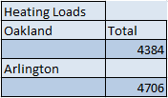
I
N
T
R
O
S
USTA
I
N
AB
L
E
HEATING AND COOLING LOADS
E
X
I
S
T
BREADTH
LOADS CALCULATED FOR SOUTH FACING OFFICE
FOLLOWED ASHRAE HANDBOOK FUNDAMENTALS (2009)
EXISTING ARLINGTON LOADS
COMPARISONS
D
E
P
T
H
SIMPLIFYING ASSUMPTIONS
C
M
STEADY STATE CONDITIONS
SINGLE OUTSIDE TEMPERATURE
NO HEAT GAIN FROM SOLAR OR INTERNAL SOURCES
S
U
S
T

Slide 24
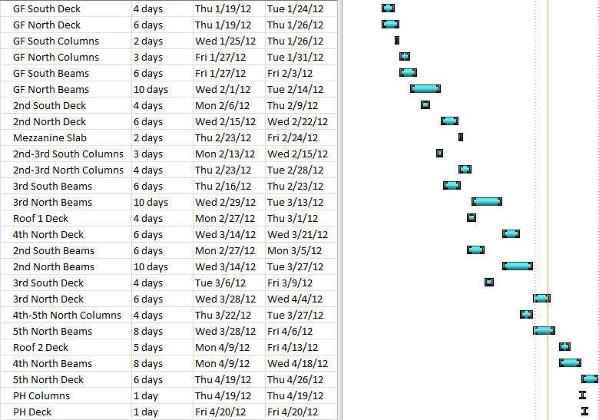
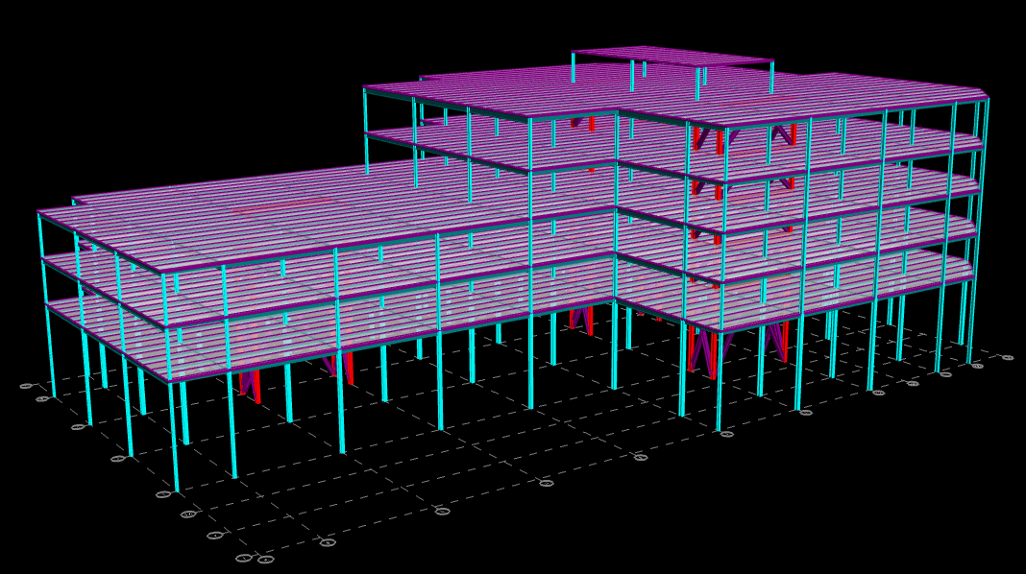
CONCLUSIONS
STRUCTURAL DEPTH
CONSTRUCTION MANAGEMENT BREADTH
SUSTAINABILITY BREADTH
LEED SITE OPPORTUNITIES
GREEN ROOF PERFORMANCE
PHOTOVOLTAIC PANEL PERFORMANCE
HEATING AND COOLING LOADS
LEED RATING MAINTAINED
CONCRETE STRUCTURE : INCREASED WEIGHT AND REINFORCEMENT
STEEL REDESIGN : 3 INTERIOR SPECIALLY BRACED FRAME CORES
MINIMIZED EFFECTS DUE TO TORSION
PERMISSIBLE DRIFT VALUES
NORTH AND SOUTH CONSTRUCTION
FASTER CONSTRUCTION TIME
LOWER COST

Slide 25
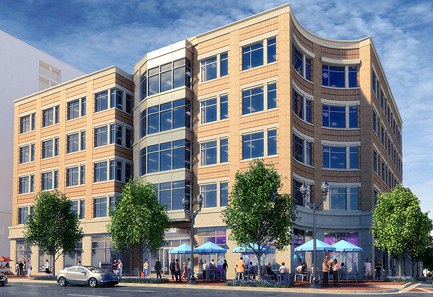
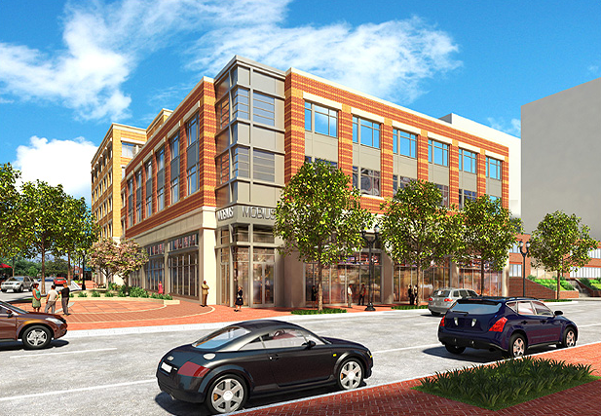
C
M
B
R
E
A
D
T
H
Penn State University
Senior Thesis 2012
Faculty Advisor: Thomas Boothby
Joshua Urban
Structural Option
THANK YOU
QUESTIONS/COMMENTS

Slide 26
C
M
B
R
E
A
D
T
H
CONNECTION CONSIDERATIONS
Penn State University
Senior Thesis 2012
Faculty Advisor: Thomas Boothby
Joshua Urban
Structural Option
REQUIRED TENSION STRENGTH : RyFyAg OR MAXIMUM LOAD EFFECT
REQUIRED FLEXURAL STRENGTH : 1.1RyMp
REQUIRED COMPRESSIVE STRENGTH : 1.1RyPn

Slide 27
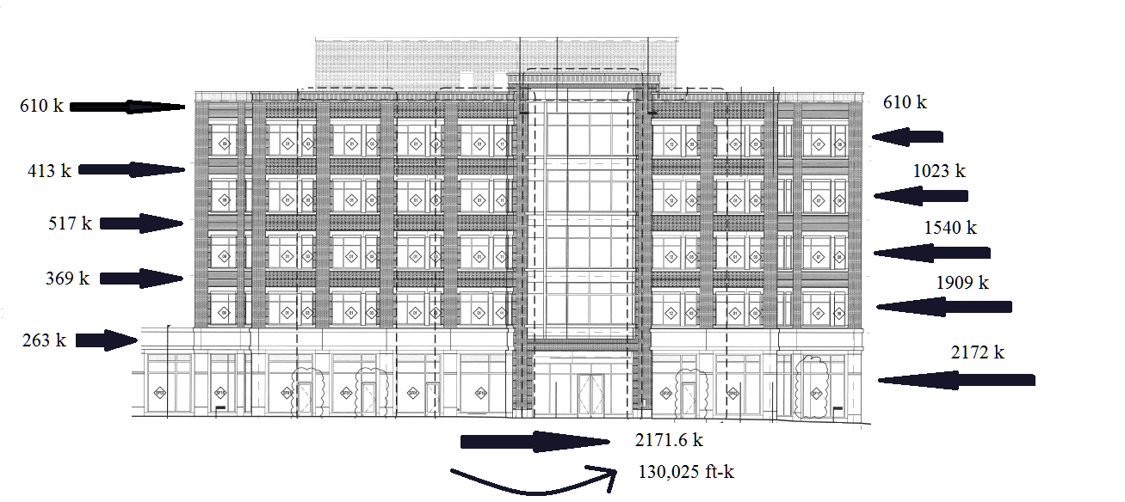
SEISMIC LOADS
C
M
B
R
E
A
D
T
H
Penn State University
Senior Thesis 2012
Faculty Advisor: Thomas Boothby
Joshua Urban
Structural Option

Slide 28
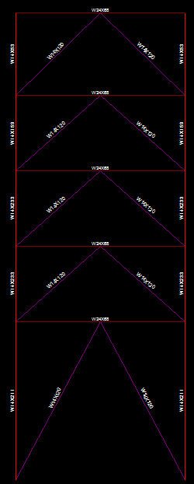
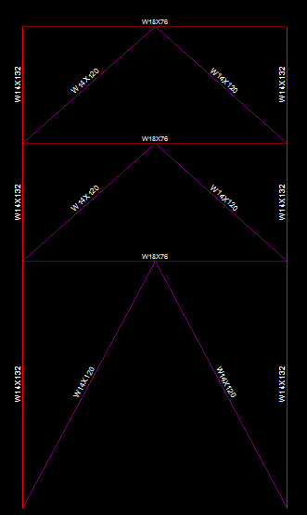
BRACED MOMENT FRAMES
C
M
B
R
E
A
D
T
H
Penn State University
Senior Thesis 2012
Faculty Advisor: Thomas Boothby
Joshua Urban
Structural Option

